Slide 1



Arrest Data - Reported Number of Adult Arrests by Crime
CS1003 Final Course Project
Adewale Omoniyi, Adesola
1

Slide 2
Background/Motivation
Crime is an act against the law and a threat to the well-being of the society and arrests are usually made to prevent crime and preserve law and order.
The Federal Bureau of Investigation (FBI) have been collecting crime data in the United State through the Uniform Crime Reporting (UCR) Program. Detailed information that pinpoints the types and trends of crime within a community is invaluable to the design of crime prevention policies (Girard, 2020, p. xx).

Slide 3
Problem Statement
Law enforcement agencies and Policy makers need to know the trends of arrest across gender, age and race over the past years in order to assess the effectiveness of their campaigns and/or evaluate the effectiveness of the crime prevention/control policies in place.
Project Goal
The goal of this project is to evaluate the effectiveness of the crime control/prevention policies in the United State by studying trends in arrest data over a period of 23 years.

Slide 4
Analysis Questions
How does arrest trend vary across race?
How does arrest trend vary across gender?
How does arrest trend vary across age groups?
Which year had the highest and lowest arrest rate per 100,000 populations?
Dataset Description
The analysis will be based on Arrest Data; Reported Number of Adult Arrests by Crime in the United State.
It contains the yearly number of arrests of adults for various offences obtained from the FBI crime data explorer as reported by participating law enforcement agencies from 1995–2016.
The arrests are by offense and broken down by age, gender and race.

Slide 5
Dataset Description
It contains 644 observations (rows) over 47 features (columns).
The age and race distribution spans through 32 & 4 columns respectively.
It covers a period of 23 years for 28 different offenses with approximately a yearly average of 73,000 female arrested and 249,000 male arrested.
In the year 1994, a record high of 2,236,508 male arrest was made for all other offenses
In 2016, a record high of 675,720 female arrest was made for all other offenses.
Conversely, a record low of 526 male arrest was made in the year 2013 for Suspicion
Also in the year 2012, a record low of 127 female arrest was made for rape.
The average yearly arrest of White, black, Asian pacific islander and American indian are 219800, 92,400, 3,600 and 4,400 respectively.

Slide 6
Exploratory Data Analysis (EDA) and Visualization
The dataset was inspected for missing values and was also checked for data integrity.
We created 4 different age categories (youth, young age, middle age and elderly) from the 32 age columns based on the 2015 revised United Nation (UN) Age standards (Dyussenbayev, 2017, p. xx).
The 28 offenses for which arrest was made, was also broken down into two distinct categories Part I and Part II based on the FBI classification ("Persons arrested," n.d.)
Trend of the arrest categories over the 23-year period was computed for
Gender
Age category and
Race

Slide 7
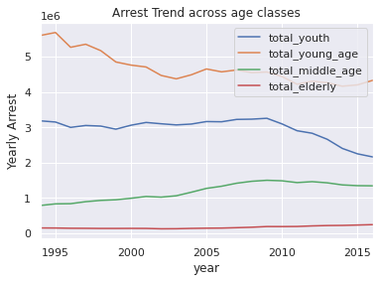
Exploratory Data Analysis (EDA) and Visualization
Trends across the Various age groups
Most arrested – Young age
Significant drop
Least arrested – Elderly
Increased arrest
Youth
Sharp decrease over last 5 years
Middle Age
Increased arrest

Slide 8
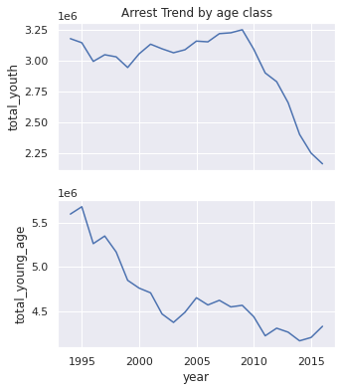
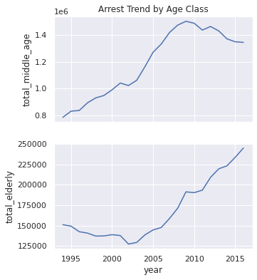
Exploratory Data Analysis (EDA) and Visualization
Trends across the Various age groups

Slide 9
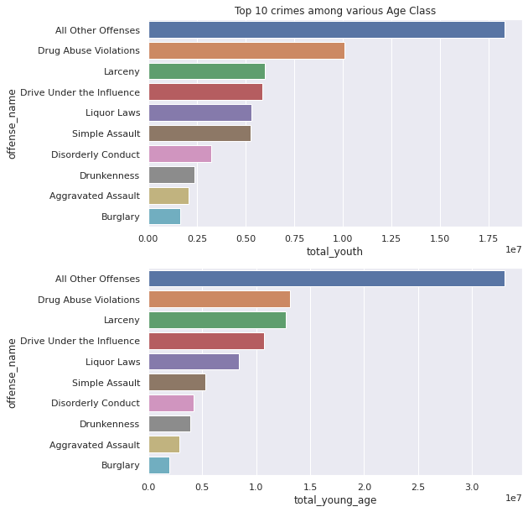
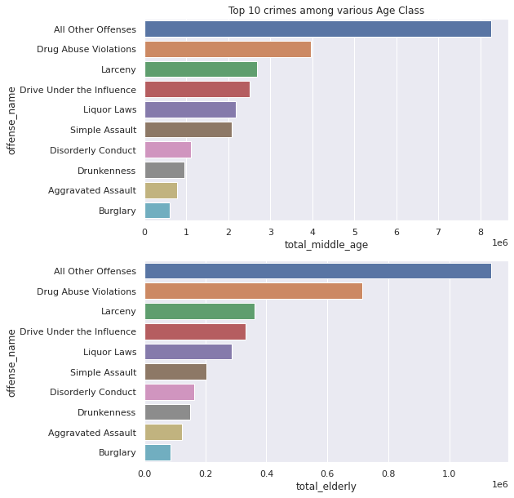
EDA and Visualization
Arrest for crimes follows the same pattern among all classes with All Other Offences being dominant

Slide 10
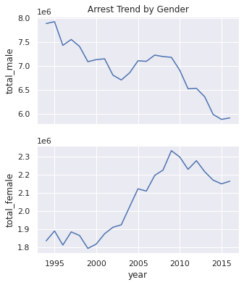
Exploratory Data Analysis (EDA) and Visualization
Trends Across Gender
Approimately, yearly ratio of arrested female is 20%
Significant reduction of about 24% in male arrest
Significant increase of about 17% in female arrest

Slide 11
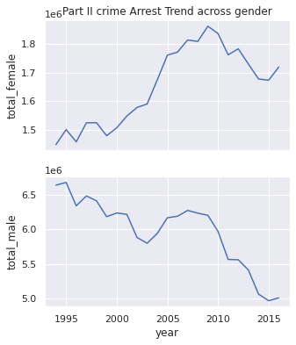
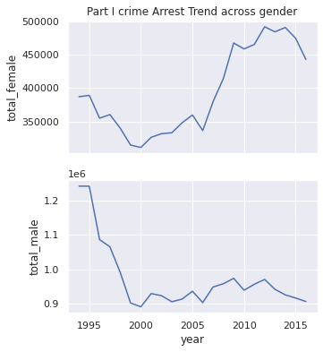
EDA and Visualization
Part 1 and Part 2 Crime Arrest Trends Across Gender

Slide 12
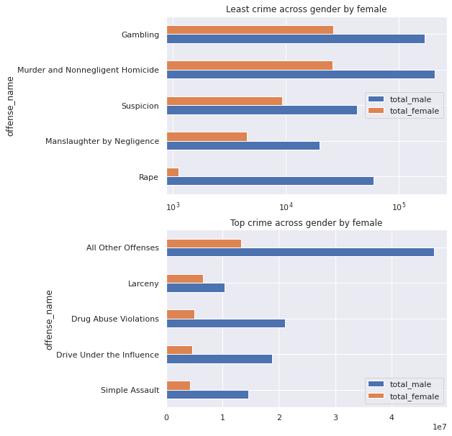
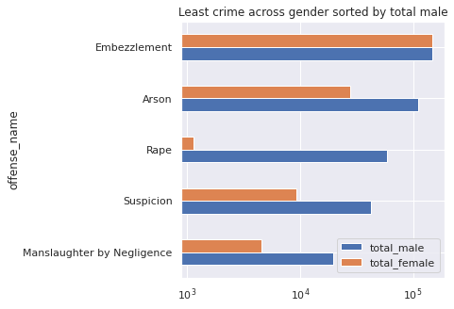
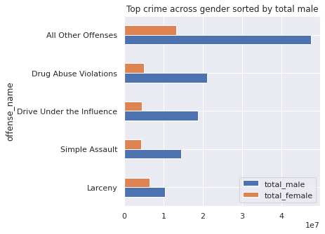
EDA and Visualization
Arrest for crimes follows different pattern between the two genders. However All other offense remains most dominant across board

Slide 13
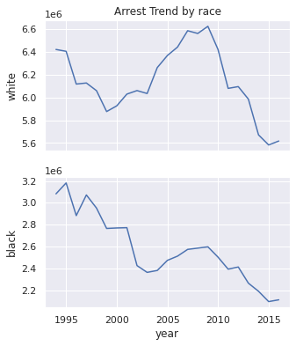
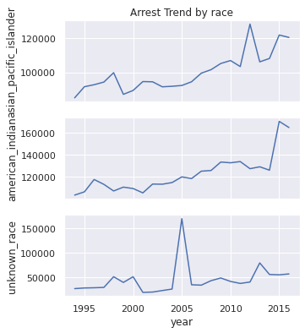
Exploratory Data Analysis (EDA) and Visualization
Trends Across Race
Pacific Islanders and American Indiana Asian shows similar increase in arrest trends
Whites shows an oscillatory arrest trend pattern

Slide 14
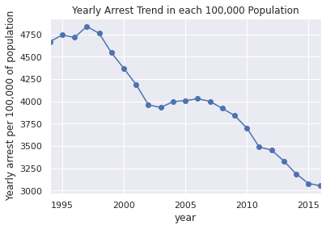
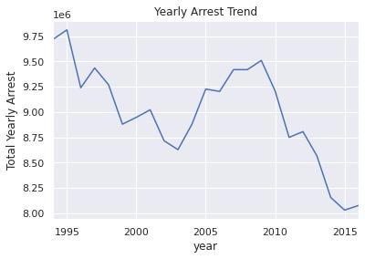
Exploratory Data Analysis (EDA) and Visualization
Arrest Rate Per 100,000 Populations
1997 had the highest arrest proportion of about 4800 in every 100,000 population
2016 had the least arrest proportion of about 3040 in every 100,000 population

Slide 15
conclusions and Recommendations
Overall, there have been significant reduction of about 35% in the number of crime arrest made in the United State (US) within the period under consideration.
This is largely due in part, to the drastic reduction in the number of male arrest which was about 80% of total arrest in 1994 and about 70% in 2016
Despite the overall reduction in crime arrest, an unpleasant growth in the number of crime arrest of the female gender, elderly, middle age, American Indian and Asian Pacific Islanders was observed.
We can infer that the current crime prevention/control policies/campaigns in the US have been largely successful in part as it’s most effective in checkmating the male gender and blacks

Slide 16
conclusions and Recommendations
There is need for policy makers and law enforcement agencies to review the current crime prevention /control policies, to adequately checkmate the increasing trend of crime among the middle age, elderly, American Indian, Asian Pacific Islander and the female gender.

Slide 17
References
Crime in the United States. (2021, July 6). Robert Presley Center of Crime and Justice Studies. https://presleycenter.ucr.edu/article-compendium/2021/07/06/crime-united-states
Dyussenbayev, A. (2017). Age periods of human life. Advances in Social Sciences Research Journal, 4(6). https://doi.org/10.14738/assrj.46.2924
Girard, C. M. (2020). Planning, management, and evaluation. Handbook of Loss Prevention and Crime Prevention, 475-487. https://doi.org/10.1016/b978-0-12-817273-5.00042-9
(n.d.). notitle. https://crime-data-explorer.fr.cloud.gov/
Offense definitions. (n.d.). FBI. https://ucr.fbi.gov/crime-in-the-u.s/2019/crime-in-the-u.s.-2019/topic-pages/offense-definitions
Persons arrested. (n.d.). FBI. https://ucr.fbi.gov/crime-in-the-u.s/2019/crime-in-the-u.s.-2019/topic-pages/persons-arrested
(n.d.). Roseville, MN - Official Website | Official Website. https://www.cityofroseville.com/DocumentCenter/View/26568/Description-of-Uniform-Crime-Offenses
Walden University. (2019, January 14). Why-national-crime-statistics-are-important. Accredited Online University | Walden University. https://www.waldenu.edu/online-bachelors-programs/bs-in-criminal-justice/resource/why-national-crime-statistics-are-important

Slide 18
Thank You

